Slide 1
Smart-Grid Cyber Attack Detection and Prevention Strategies
CPRE 550
Abir Mojumder

Slide 2
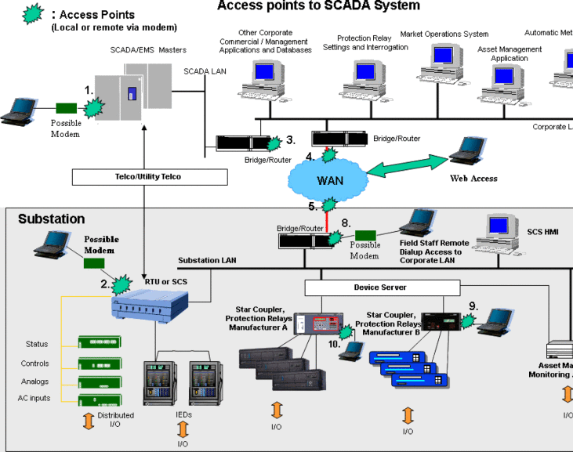
Smart-Grid Infrastructure
Corporate Network
Control Center Network
Workstation with Control software (SICAM PAS)
Substation Networks
IED Relays
RTU Devices
Routers/Switches

Slide 3
Common Weak Points
Infiltrate via Email attachments, social engineering attacks on the corporate department
A lot of power grids still use Legacy Software/OS for compatibility issues.
These have known vulnerabilities. Can be exploited fairly easily
DNP3 Protocol used for Control center – Substation communication is simple, no default encryption.
Any internal system infiltration can perform control center level commands.

Slide 4
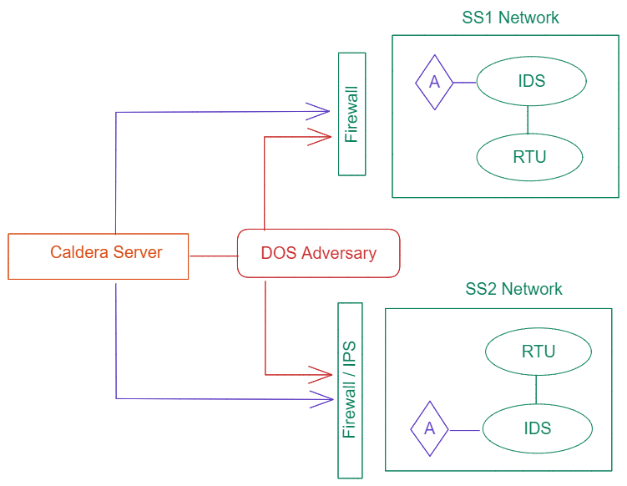
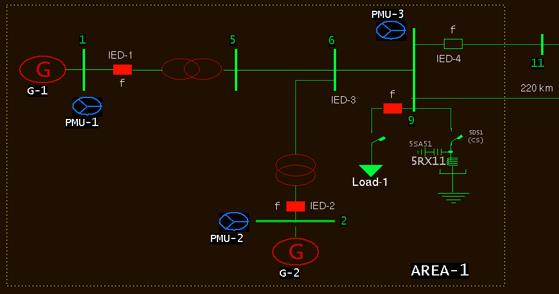
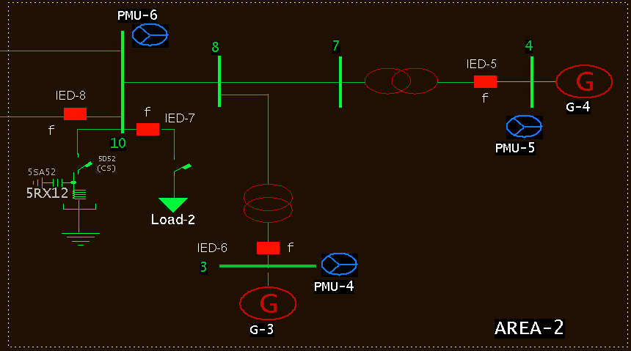
Experiment Testbed – MITRE CALDERA
Try out some experiments on ISU’s PowerCyber Testbed
Opted to use MITRE CALDERA Adversary Emulation framework
Testbed Substation Schematic
Experiment Network Diagram

Slide 5
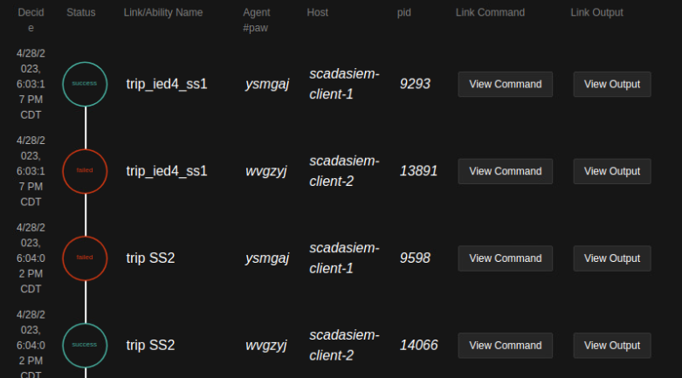
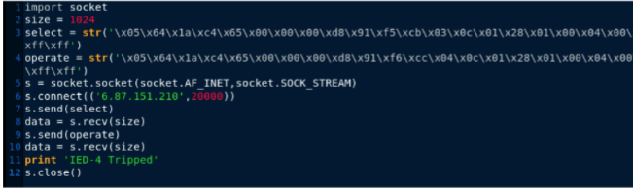
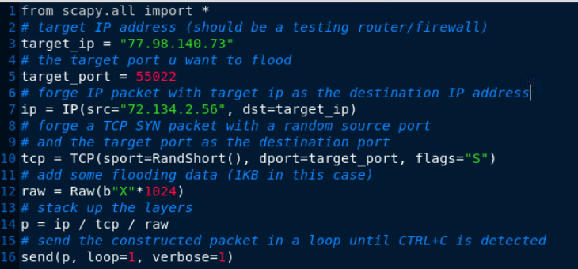
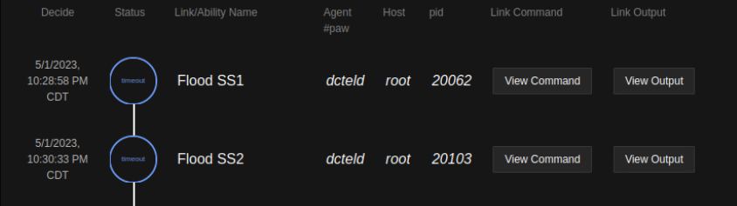
Attack Implementation
Perform 2 Attack Scenarios: Relay Tripping and Denial of Service
Relay Tripping Payload
Trip Attack Execution
DoS Flood Attack Execution
DoS (SYN Flood) Payload

Slide 6
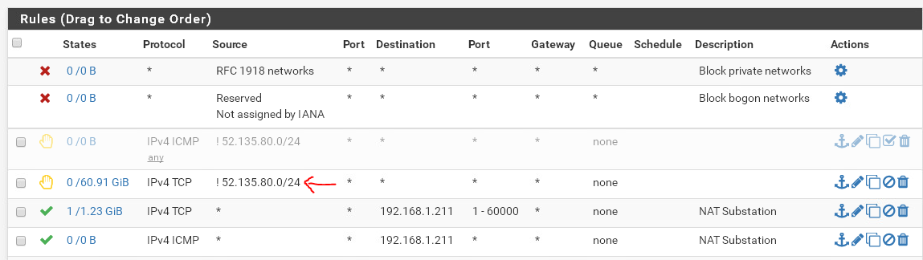
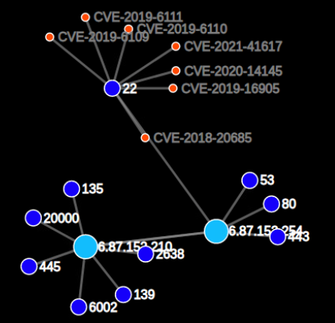
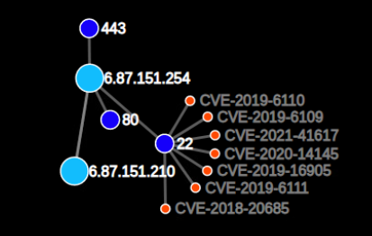
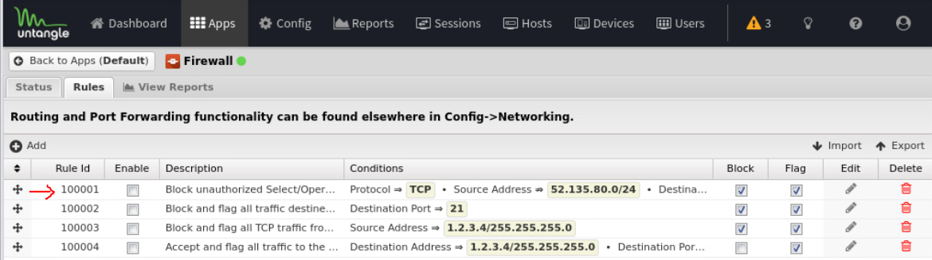
Defense Strategies
Network Isolation is one of the best practices for reducing risk of infiltration
2-Factor authentication in control center systems
Encryption of data transferred using DNP3 protocol
pfSense Firewall and Untangle Firewall/Intrusion Prevention System
* CALDERA Pathfinder tool for detecting known Vulnerabilities:

Slide 7
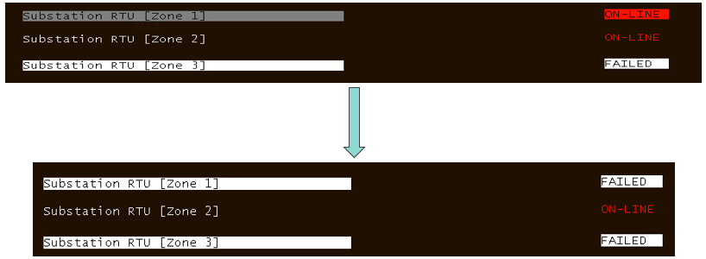
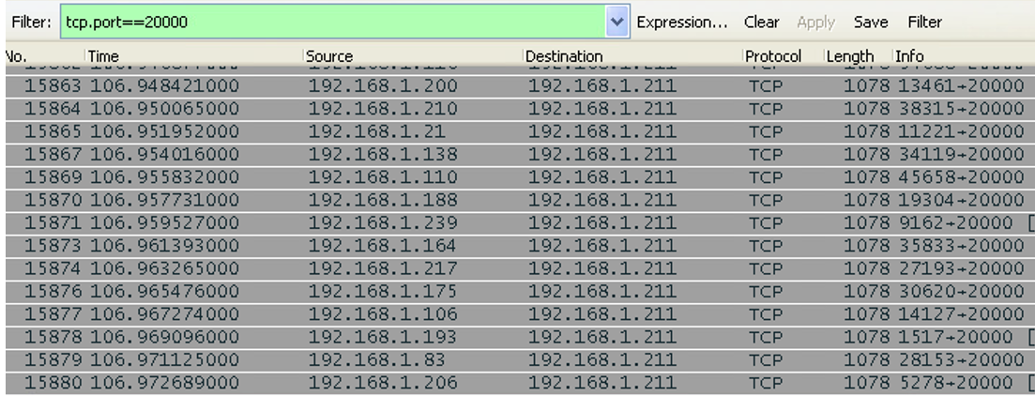
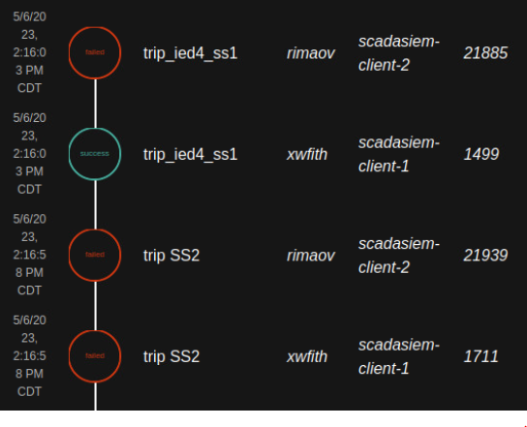
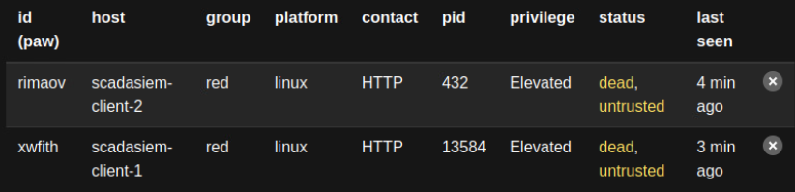
Results
Attack without Firewall:
Substation Failure after Trip/DoS attack
Packet capture of flood attack in SS1
Attack with Firewall (and IDS)

Slide 8
Conclusion
Using tools like CALDERA for Power grid Environments requires a lot of customized plugins/functionality to properly test the system
It is still helpful to understand common adversary scenarios.
The tool comes preinstalled with Discovery, Infiltration, Execution, Exfiltration Tactics based on MITRE ATT&CK Framework.
ISU’s Testbed has vulnerabilities with older OS/Services running on them. (Windows XP and Server 2000). DNP3 packets are easy to monitor and perform replay attacks (Unauthorized Tripping relays)

